Slide 1
Sessions 2
Security Attacks

Slide 2
Three Aspects of Security
The three aspects of information security are
  security attack
  security mechanism (control)
  security service
Some terms
  threat – a potential for violation of security
  vulnerability – a way by which loss can happen
  attack – an attempt to avoid security services

Slide 3
Types of Attacks
Passive Attacks
(a) Release of message content
(b) Traffic Analysis
Active Attacks
(a) Masquerade
(b) Replay
(c ) Modification of message
(d) Denial of Service

Slide 4

Passive Attack
(a) Release of message Contents

Slide 5
Passive Attack
(b) Traffic Analysis
Observe pattern of
Message from
Bob to Alice

Slide 6
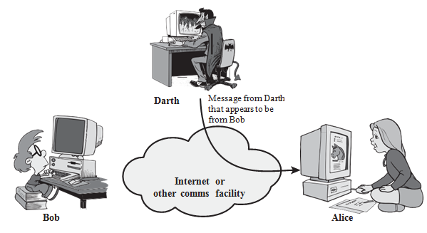
Active Attack
(a) Masquerade

Slide 7

Active Attack
(b) Replay

Slide 8
Active Attack
(c) Modification of message
Modify message

Slide 9
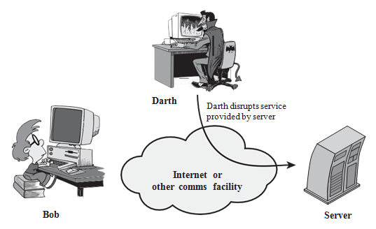
Active Attack
(d) Denial of Service

Slide 10
Handling Attacks
  Passive attacks – focus on Prevention
    Easy to stop
    Hard to detect
  Active attacks – focus on Detection and Recovery
    Hard to stop
    Easy to detect

